Slide 1
Dependency Injection by setter method
We can inject the dependency by setter method also.
The <property> sub-element of <bean> is used for setter injection.
We can inject
primitive and String-based values
Dependent object (contained object)
Collection values etc.

Slide 2
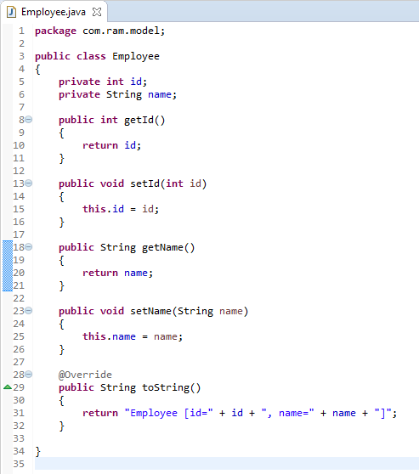
Dependency Injection by setter method

Slide 3
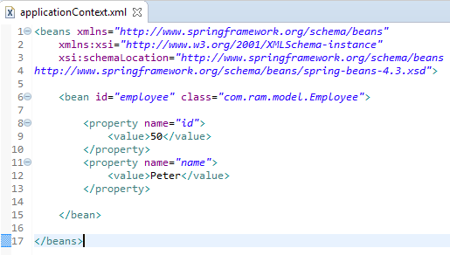
Dependency Injection by setter method
We are providing the information into the bean by applicationContext.xml file.
The property element invokes the setter method. The value sub-element of property will assign the specified value.

Slide 4
Dependency Injection by setter method
Employee
What objects to instantiate?
What objects to configure and how to configure?
The Spring Container
(ApplicationContext)
applicationContext.xml
Employee
Object
id=50,
name=Peter
Create the employee object.
Configure the employee object.
Manage employee object complete life cycle from creation till destruction.

Slide 5
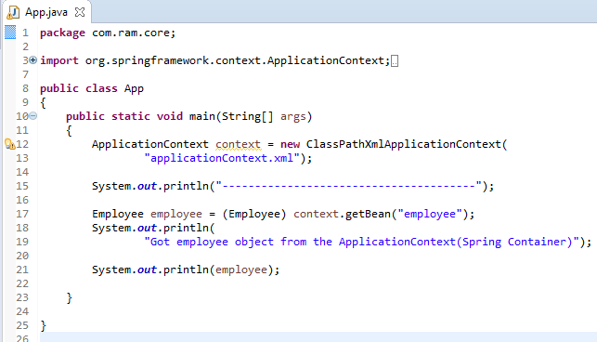
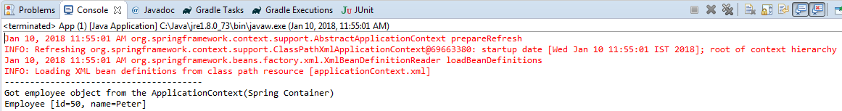
Dependency Injection by setter method

